Slide 1

Java Features

Slide 2
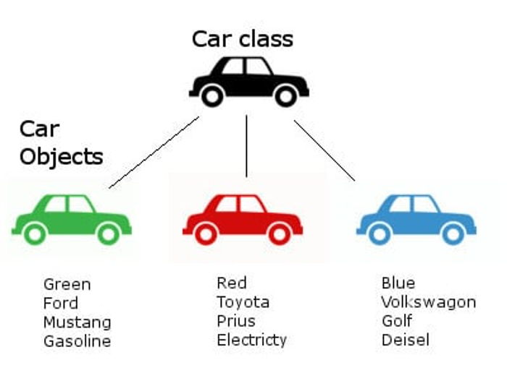
Object Oriented Programming (OOP)
Object oriented technique is modeled on the real world that we see all around.
A car represents a "class" meaning , it represent certain basic attributes and behavior.
Audi A4 is an actual ‘object’ of the ‘class’ of cars.
There could be class of Animal, class of Plants, class of bikes etc.
Object Oriented Programming (OOP)

Slide 3
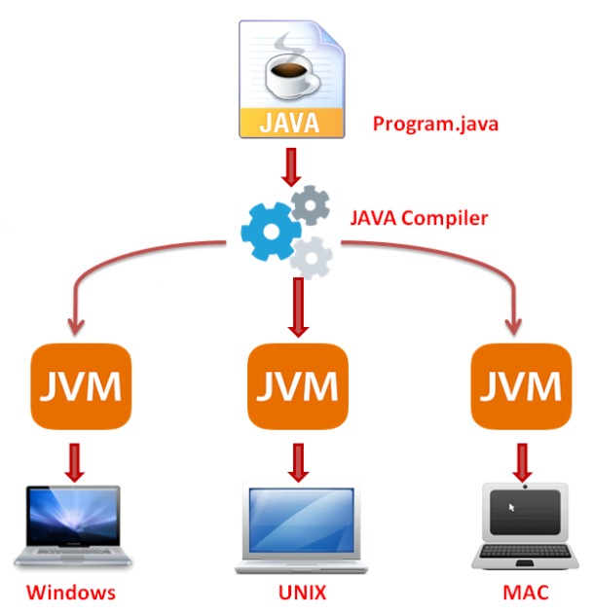
Write once, Run Anywhere
A java program once compiled can be taken and run on any system/processor which has the corresponding JVM installed.
This is referred to as write once and run anywhere feature of java.
This is made possible as a result of the bytecode that Java generates at the end of compilation process.
Java also provides JVM implementations for major OS/processor types like windows,unix,mac etc.
The bytecode then gets executed on platform specific JVM.

Slide 4
JDK : The Java Development Kit
The java software that is downloaded is referred to as Java Development Kit (JDK).
The JDK comes with many tools along with many set of classes referred to as Application Programming Interface (API). The programmer while writing code to implement his desired functionality can make use of these JDK APIs.
Some of the tools bundled with JDK are :
Javac : Java compiler
Java : JVM responsible for running a Java program
Jvisualvm : Responsible for visualizing a running java application.
Java development kit (JDK) is a combination of the Java Runtime Environment(JRE) + Development tools.
Java Runtime Environment is a combination of Java virtual machine (JVM),a program that runs the java code, and collection of core java APIs.

Slide 5
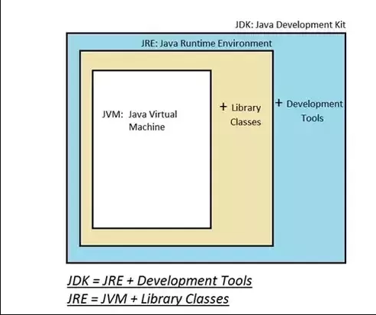
JVM vs JRE vs JDK
Figure shows the contents of Java development kit (JDK).

Slide 6
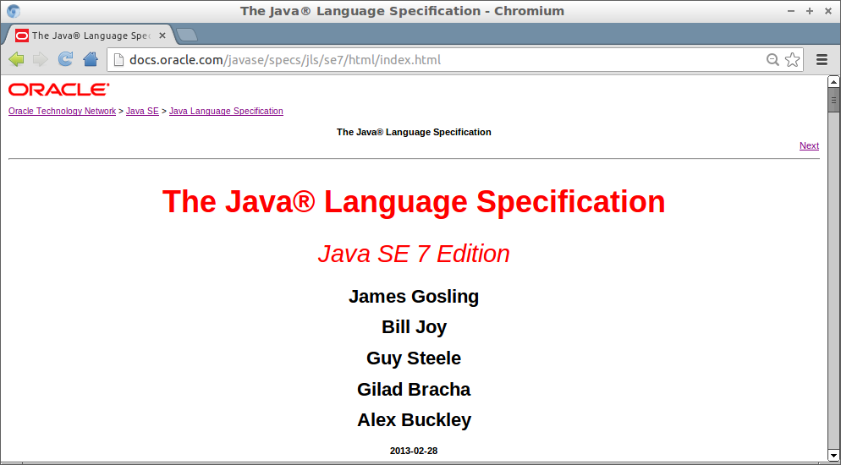
Java Specification
Java language specification is a document that defines essential parts of a java language implementation.
It defines all necessary grammar rules and syntax for java language.
Similarly there is a java virtual machine specification and JVM is a reference implementation for it also commonly referred to as Hotspot VM.
There are many other implementations of the JVM specification like Azul Zulu, Eclipse OpenJ9.

Slide 7

Memory Management
Java provides in-built memory management facility.
Java’s memory manager is referred to as Garbage collector.
A java programmer does not need to take care of creating and destroying memory.
Earlier in languages like C , it was required to first reserve memory and after usage it had to destroyed. The programmer was required to perform all the memory allocation and releasing work.
This caused too many memory leaks.
A memory leak happens when the programmer allocated some memory and then forgot to deallocate it. This memory was practically unusable because it remained acquired and unusable for rest part of the program.
In Java however, a programmer can just signal the garbage collector to run but it is the sole responsibility of java runtime system to run garbage collector.
A Java programmer still needs to take care that he writes code that is memory efficient.

Slide 8

Questions ??

